Slide 1
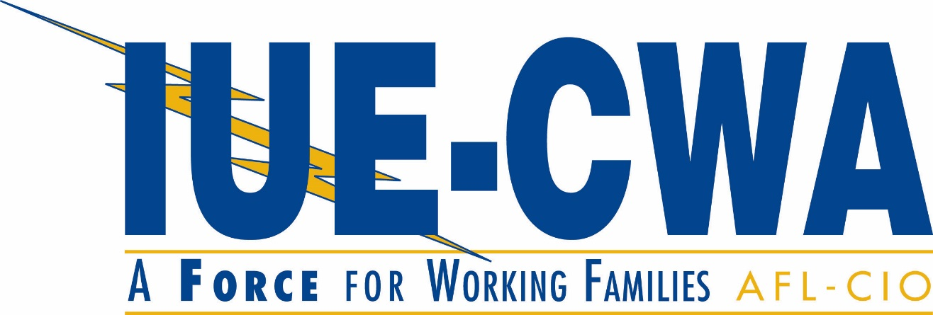
Welcome to IUE-CWA: An Introduction to your local union

Slide 2
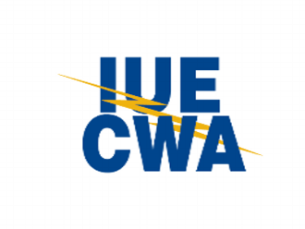
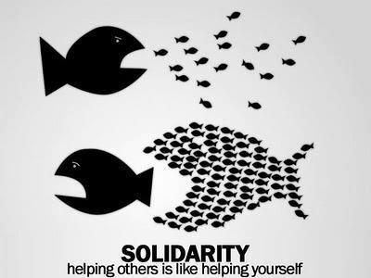
Your Union

Slide 3
What Is A Union?
A union is a democratic organization in which workers harness their collective power fight for fair wages, benefits, and working conditions.

Slide 4
The Power of Your Union
Your union is here as a way for to you join in and protect your rights, and the rights of your co-workers on the job.
Years ago, workers at this facility came together and voted to form a union, so they could fight for: safety on the job, fair wages, fair treatment, benefits, etc.
Our work as the union continues today. All the wages and benefits we have are at risk if we don’t stand together.
Our union is only as strong as our members.
We need everyone to be a part of it.

Slide 5
What does that look like?
Unions are at their best when members are unified in the fight for:
A strong collective bargaining agreement
Grievances and arbitrations for members who have been wronged
Dignity in the workplace
Political power to force our elected officials to enact pro-worker and pro-working family legislation

Slide 6
Some Definitions
Collective Bargaining Agreement (CBA): A legally binding contract negotiated between management and union officials.
Grievance: A process, guaranteed in the CBA to protect workers from management violations or misinterpretation of the agreement.
Arbitration: A legal proceeding the union employs when the grievance procedure fails to reach a just conclusion.

Slide 7
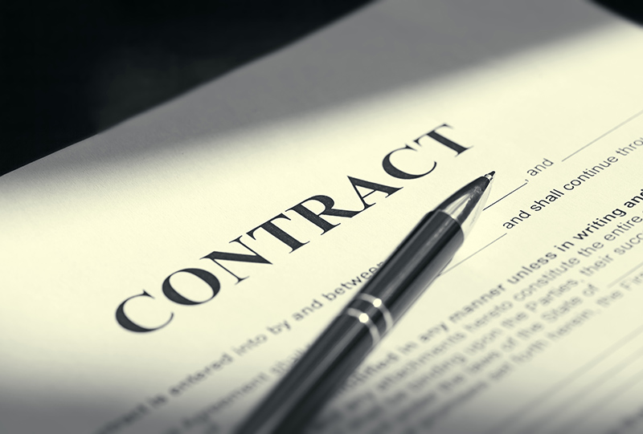
How we enforce our rights at work: The contract
Here are some key aspects of our local union contract:
Wages
Seniority
Health care
Sick days
Vacation
Discipline
Our Union is Our Power
Everything that is in our contract we have won through standing together as a union and negotiating with the company.
If we don’t have our union, the company get rid of the contract, and get rid of what we have fought for.

Slide 8
What has our local won?
Better wages and working conditions
Rules that govern what the company can and cannot do
Just cause, ensuring that the company does not discipline or terminate employees who have not substantially violated workplace rules
Many grievances and arbitrations that enforce the CBA

Slide 9
Your point of contact in your union– your area steward
Stewards are there if you have a question or concern about work.
Your steward will introduce themselves once you start at work.
Stewards are elected by the membership.

Slide 10
Nothing happens in a union without the consent of membership.
Membership votes on:
Local Leadership
National Leadership
Contract ratification
Changes to Constitutions and Bylaws (governing documents)
Taking action against management
Democracy: The Cornerstone of your Union

Slide 11
Where do My Dues Go?
Dues pay for every part of your union structure. Examples include:
IUE-CWA Staff: Staff Rep, Organizers, Lawyers, LEAN Program staff, Accountants, Officers lost time, etc.
Your union hall or other meeting space
Social gatherings
International offices
Organizing new members
Your dues DO NOT pay for political activity.

Slide 12
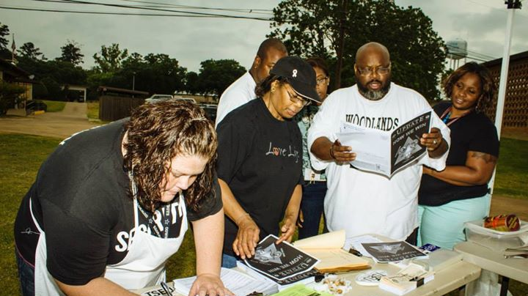
How Is Union Leadership Chosen?
Leadership is elected by the members
Elections are held every three years
All positions are elected

Slide 13
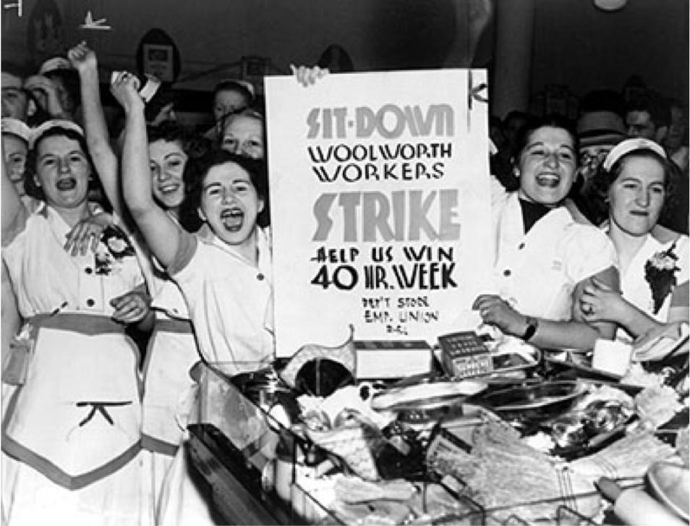
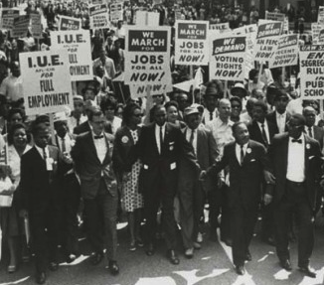
Our Union – bigger than our workplace.
Workers have been on the front lines of demanding justice for the middle class – and we still are today.
Notes:
SLIDE 4
In 1955, one-third (33%) of the workers in the United States were union members, compared with only 11.3% today.*
Collective bargaining raised the bar on wages and benefits for both union and nonunion workers.
As a result, many families during these years climbed up the economic ladder.
* Source: Bureau of Labor Statistics, 2013.

Slide 14
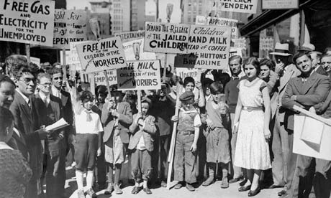
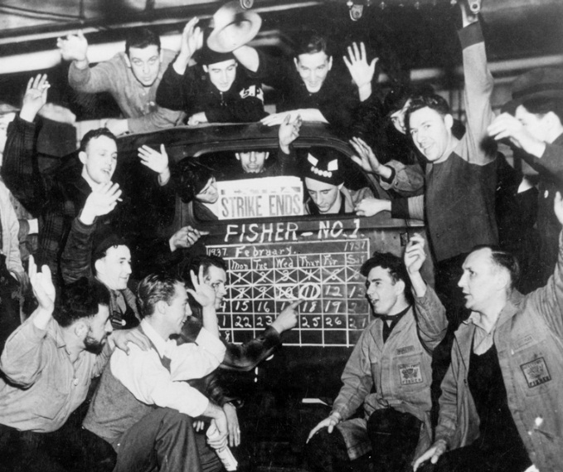
Victories Won by the Labor Movement on a Bigger Scale
National Labor Relations Act, 1935
The law that guarantees your right to collectively bargain and protects your right to fight for fairness at work
Social Security Act, 1935
Fair Labor Standards Act, 1938
The law establishing minimum wage, guarantees of payment for work, the 40 hour work week, and overtime protections
Civil Rights Act, 1964
The law prohibiting discrimination in the workplace based on criteria such as race, religion, or sex
Medicare/Medicaid, 1965
Unemployment Demonstration, 1932
Flint Sit Down Strike, 1937

Slide 15
Unions & Middle Class Prosperity
1955 – 35% of American workers belong to unions; 11.3% today.
Collective bargaining raised wages and benefits for all workers.
In order to keep what we’ve won and move forward, we must stay vigilant in the face of those who seek to take our power.

Slide 16
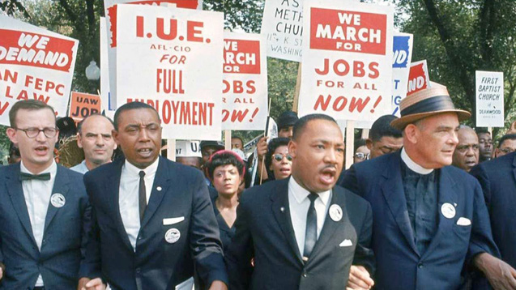
The bigger fight
Workers didn’t just fight at their workplace – they fought in the halls of congress to win these victories.
IUE members joined thousands of other union members and ally organizations to fight for justice and many legislative victories. IUE members joined with Martin Luther King Jr to demand equal rights for all in the March on Washington in 1963

Slide 17
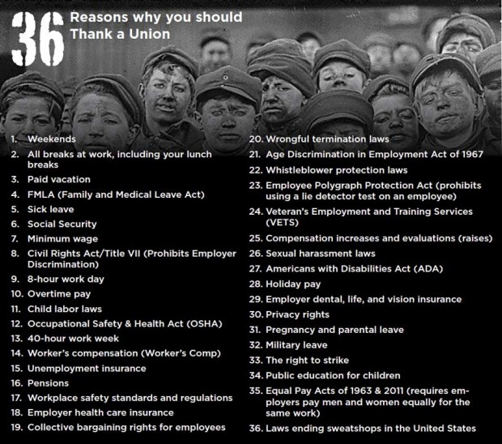
Because We Fight

Slide 18
Our work as the union today continues that fight.
We join with other labor unions and organizations to fight for our rights.
This work is happening today across the country.
You are a part of this movement!

Slide 19
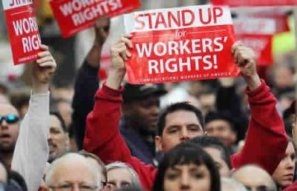
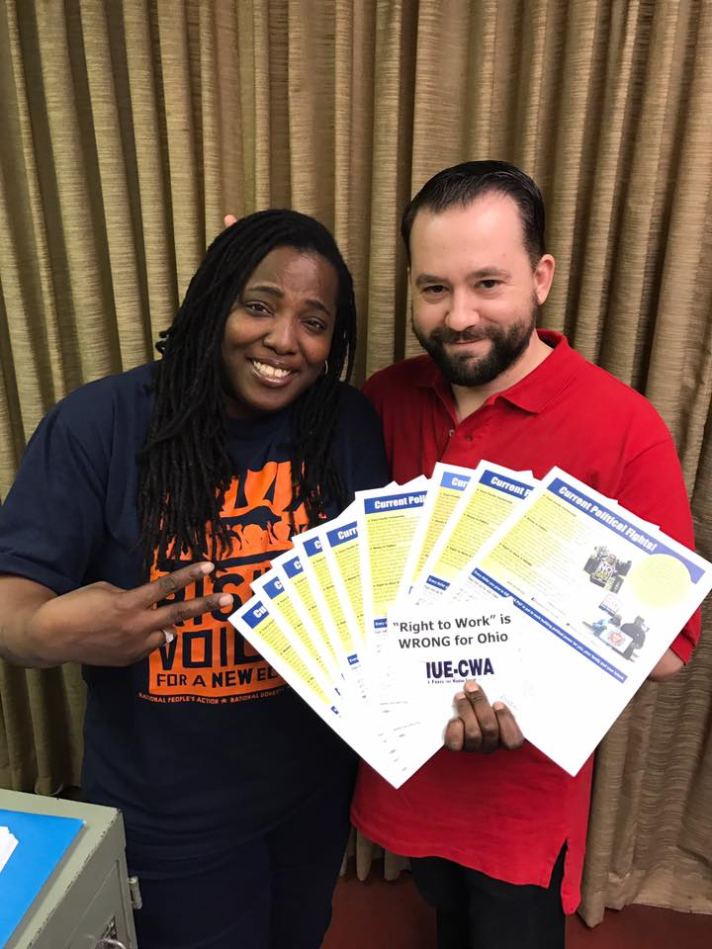
Political Action Fund
The Political Action Fund is our way to fight for our rights in the legislative arena.
IUE-CWA members contribute to the fund so we can fight against laws aimed at limiting our rights.
Here are just a few examples:
Fighting against bad trade laws that send our jobs overseas (we defeated the TPP).
Fighting laws aimed at weakening unions and lowe our wages – “Right to Work”
Fighting laws that weaken our safety protections on the job
Many your fellow union members have already joined Political Action Fund.
You can join us today!

Slide 20
Your Union: What Role Can I Play?

Slide 21
Why Should You Join Your Local Union
Solidarity
When management doesn’t think we will stick together, they do not take us seriously at the bargaining table, in grievances, or in any other confrontation that ensures fairness and dignity at work.
When we stand together, have 100% membership, and demonstrate the power of that solidarity, the union asserts its equal role in the process of setting the rules, procedures, and conditions of our employment.
Power
The more members we have, the better we can serve each other and our community.
When we have political power, we have the power to change society and politics in a way that favors working families.
When management believes that we are capable of taking everyone out on strike, they are much more likely to give us what we ask for at the bargaining table.

Slide 22
Our Union gives us Power
Power
Power to settle grievances
Power
Power to negotiate a better contract
Power
Power to create a better work environment
Power
Power to improve our community

Slide 23
Activism
As a member, you have the opportunity to impact the lives of you and your coworkers.
Ways to get involved:
Attend Member meetings
Wear your union tshirt/pin
Be a part of our mobilization team – sign up today
Join one of our local committees (charity, women’s, political) – sign up today
Be a voice – if you have a concern, voice it, don’t stay silent. Chances are, other people may share your concern.
Join the Political Action Fund today.
Write a letter, make a phone call to your senator about important political fights your union is involved in.

